Slide 1



WHAT MAKES A JOKE FUNNY?
SEBASTIAN LAVERDE ALFONSO & BATHALA SIVA
M.Sc. Computer Science for Digital Media
Big Data Architectures For Machine Learning and Data Mining
Notes:
classifiers

Slide 2
HUMOR DETECTION
What is humor?
Caleb Warren and Peter McGraw: “humor is a psychological response characterized by the positive emotion of amusement, the appraisal that something is funny, and the tendency to laugh.”
What is humor detection ?
Latent Structures behind Humor
Ambiguity
Incongruity
Interpersonal Effect
Phonetic Style
Notes:
Definitios: https://www.cs.cmu.edu/~alavie/papers/D15-1284.pdf
Ambiguity : Ambiguity occours when sentence has a multiple meanings
It’s a crucial component for many humorous jokes
Incongurity: Incongurity suggests that huomor arises when things that do not normally go together and it replaces a logic and familiarity
Eg: outcome is different
Interpersonal effects: Besides humorous theories , One important theory behind the humpr is its social factors , especially regarding inter personal effects on recievers.
i.E humor is essentially associated with the sentiment

Slide 3
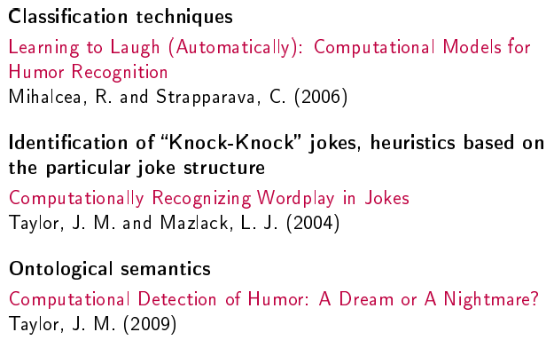
COMPUTATIONAL HUMOR
Computational humor is a branch of computational linguistics and artificial intelligence which uses computers in humor research.
Joke recognition Approaches:

Slide 4

How humor detection works?
1. We experiment with automatic classification techniques using:
(a) Heuristics based on humor-specific stylistic features (alliteration, antonymy, slang);
(b) Content-based features, within a learning framework formulated as a typical text classification task
(c) combined stylistic and content-based features, integrated in a stacked machine learning framework.
2. Use Labeled data to train a regression:

Slide 5
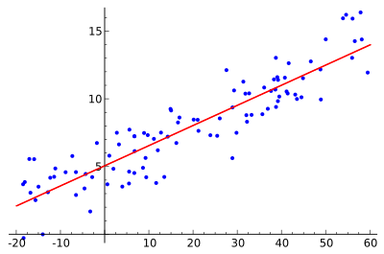
Linear Regression
What is Linear Regression ?
Linear regression attempts to model the relationship between two variables by fitting a linear equation to observed data. One variable is considered to be an explanatory variable, and the other is considered to be a dependent variable.
Linear regression is a technique for predicting a real value.
Predictions are made as a combination of the input values to predict the output value.
Each input attribute (x) is weighted using a coefficient (b), and the goal of the learning algorithm is to discover a set of coefficients that results in good predictions (y).

Slide 6
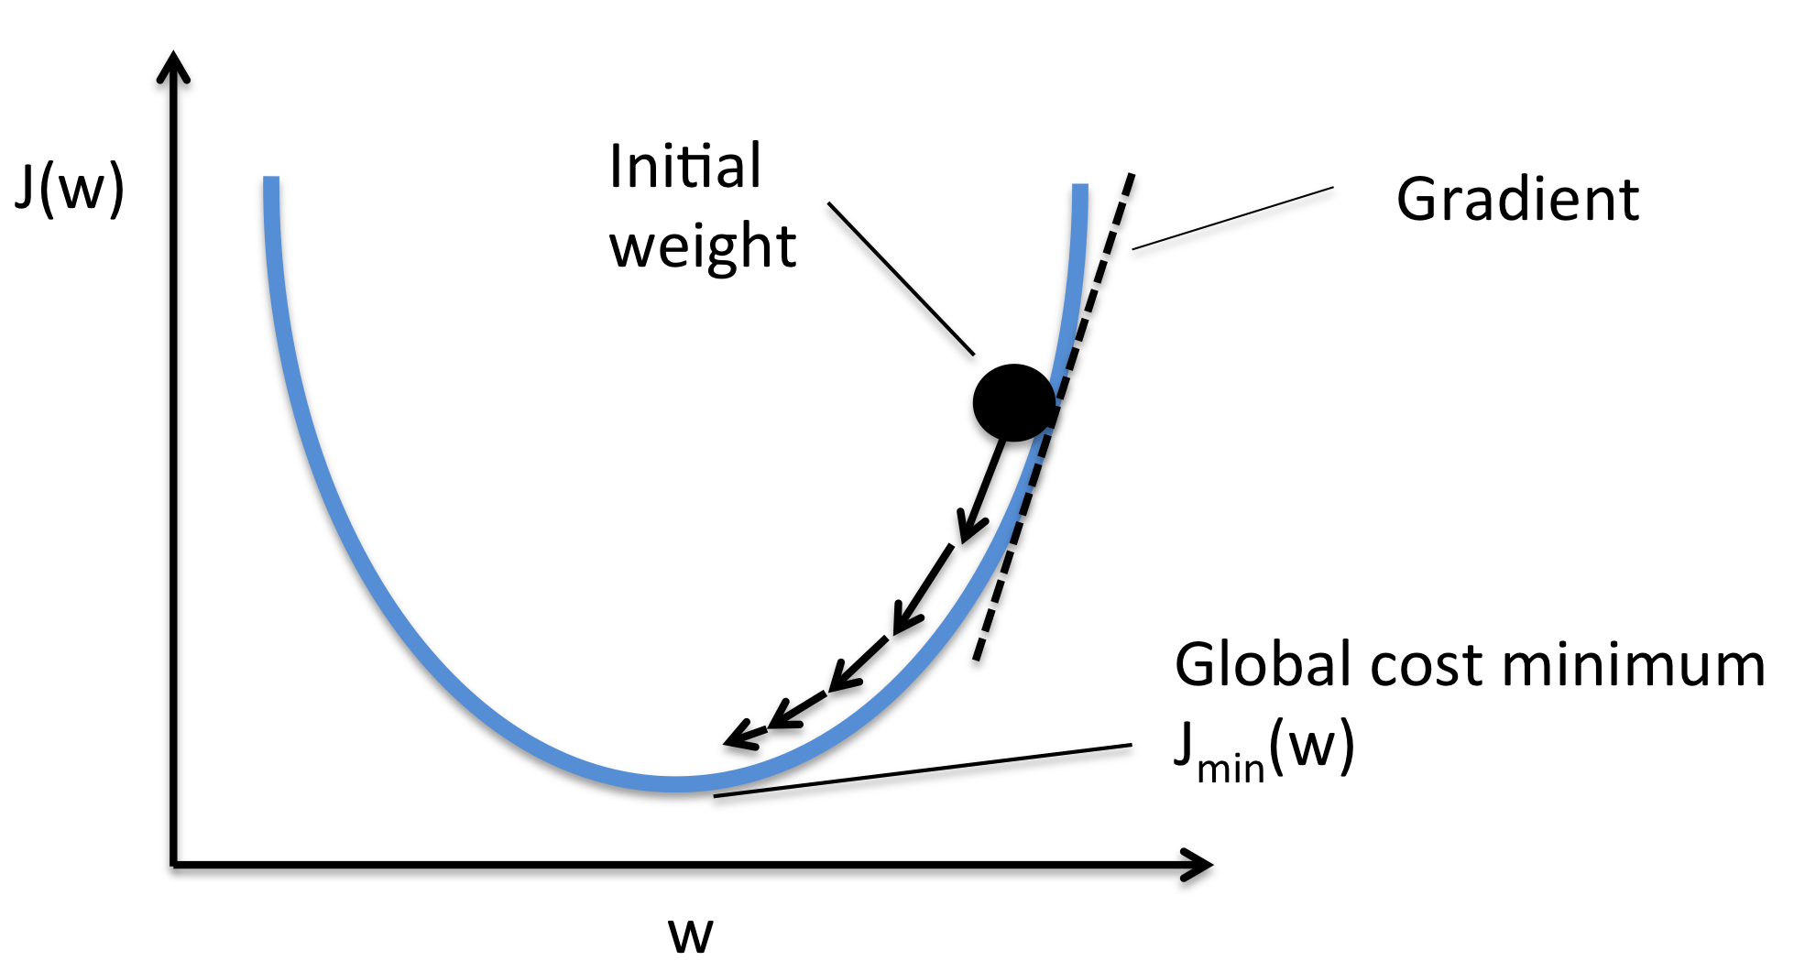
Linear Regression with SGD ?
Gradient Descent is the process of minimizing a function by following the gradients of the cost function.
In machine learning, we can use a technique that evaluates and updates the coefficients every iteration called stochastic gradient descent to minimize the error of a model on our training data.
The way this optimization algorithm works is that each training instance is shown to the model one at a time. The model makes a prediction for a training instance, the error is calculated and the model is updated in order to reduce the error for the next prediction. This process is repeated for a fixed number of iterations.
This procedure can be used to find the set of coefficients in a model that result in the smallest error for the model on the training data.
Notes:
https://machinelearningmastery.com/implement-linear-regression-stochastic-gradient-descent-scratch-python/

Slide 7
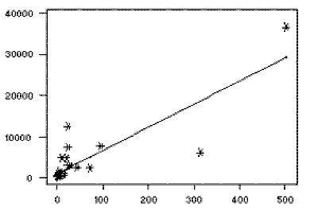
Least-Squares Regression
The most common method for fitting a regression line is the method of least-squares. This method calculates the best-fitting line for the observed data by minimizing the sum of the squares of the vertical deviations from each data point to the line (if a point lies on the fitted line exactly, then its vertical deviation is 0). Because the deviations are first squared, then summed, there are no cancellations between positive and negative values.
Notes:
http://www.stat.yale.edu/Courses/1997-98/101/linreg.htm

Slide 8
Apache Parquet
The most Apache Parquet is a columnar storage format available to any component in the Hadoop ecosystem, regardless of the data processing framework, data model, or programming language. The Parquet file format incorporates several features that support data warehouse-style operations:
Columnar storage layout
Flexible compression options
Innovative encoding schemes
Large file size
Notes:
Columnar storage layout - A query can examine and perform calculations on all values for a column while reading only a small fraction of the data from a data file or table.
Flexible compression options - Data can be compressed with any of several codecs. Different data files can be compressed differently.
Innovative encoding schemes - Sequences of identical, similar, or related data values can be represented in ways that save disk space and memory. The encoding schemes provide an extra level of space savings beyond overall compression for each data file.
Large file size - The layout of Parquet data files is optimized for queries that process large volumes of data, with individual files in the multimegabyte or even gigabyte range.

Slide 9
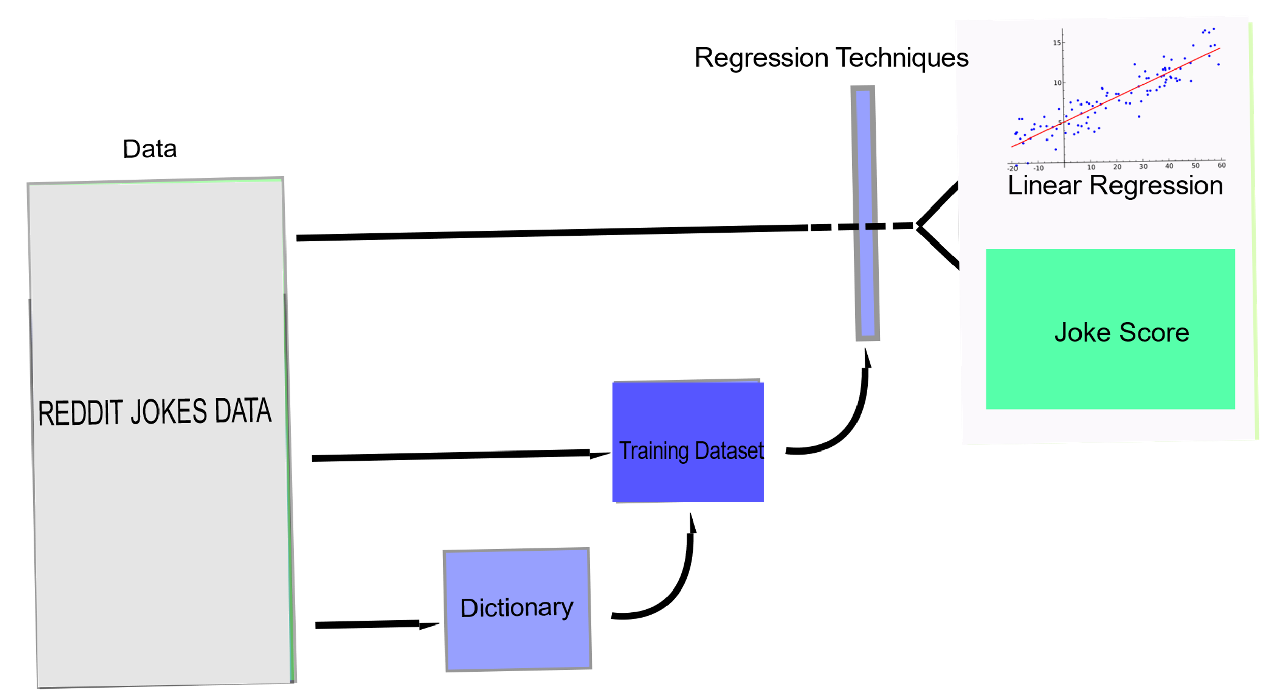
Basic Architecture

Slide 10
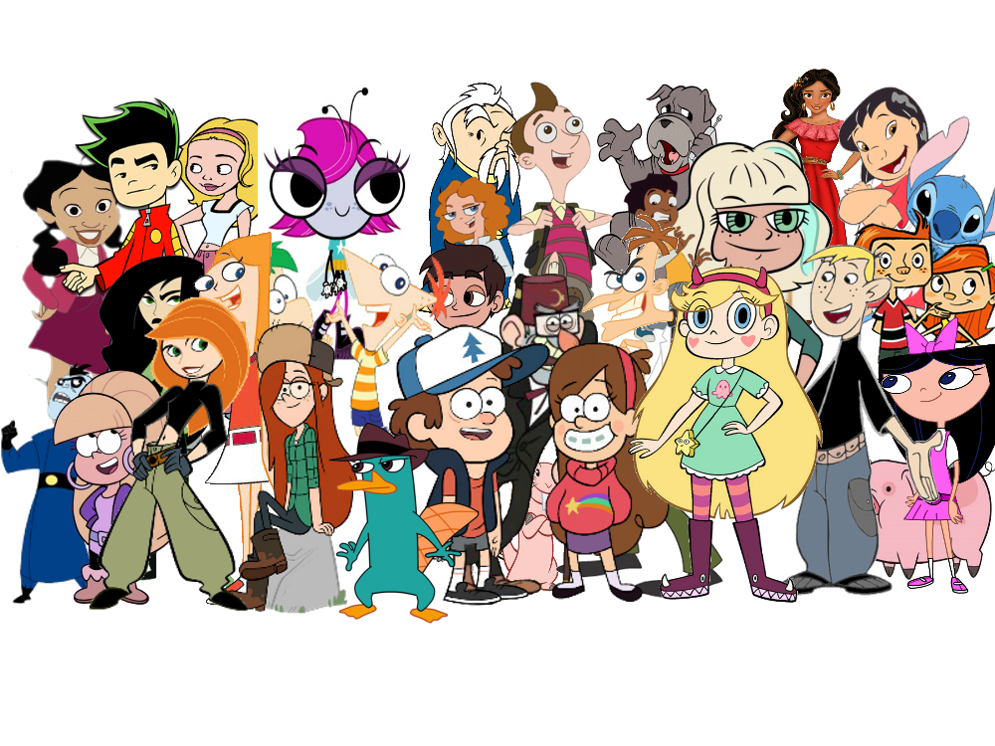


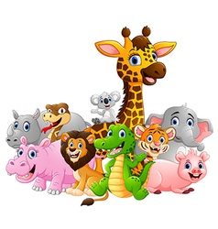

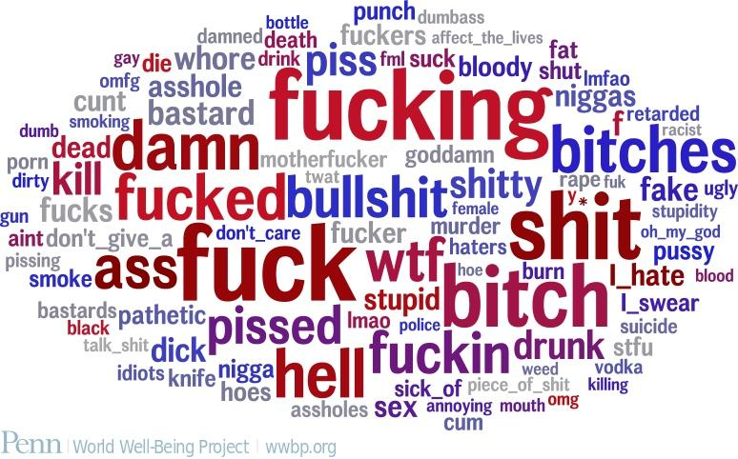
Overview of our Dictionary
Content based feature
Swear Words
Adult Slang
Nationalities
Animals
Superheroes/villains
Disney characters
High score joke words
Cartoons
Movie characters

Slide 11
Overview of the Project
Reddit Corpus
Data Frame
DataFrame
Select and Filter the Data
Creating the Data frame
Jokes Score
Creating the Model(RDD)
Splitting the Data
Creating the New features
Creating the Dictionaries
Training the Model
Running the prediction

Slide 12
Improvement
Make a better and clean dictionary
Clean the database from strange values
Add more semantic features
Run other regression with another distribution (not linear but gaussian)
Run other algorithm like decision trees and SVM
Combine them all and test a lot
Try measuring other types of error (not compared with the Average but the more typical score perhaps)
Analyse deeply the high score database
Notes:
Alliteration: This is about the repetition of phonemes in a text. It is a generalization of the rhyme. As stated in [12], structural and phonetic properties of jokes are at least as important as their content.
Ambiguity: It may be explained by the Incongruity Resolution Theory that ambiguity plays an important role, as it gives more than one interpretation to texts. Sjöbergh and Araki [22], Basili and Zanzotto [2], and Reyes, Buscaldi, and Rosso [18] mention different ways to measure it, such as counting the number of meanings of the words that appear or counting the number of possible syntax trees

Slide 13
CONCLUSION
In this project, we showed that regression techniques can be successfully applied for the question : what makes a joke funny?. Experimental results obtained on very large data sets showed that learning approaches can be efficiently used to score humorous texts.
Moreover, we have also showed that it is possible to bootstrap a very large and relatively clean corpus that falls under a certain genre (e.g. humor), starting with a handful of manually selected dataset and using filters based on document structural information and simple thematic clues.
WHAT MAKES A JOKE FUNNY?
By analysis of the linguistic features that emerged like our dictionary and identifying structures behind humor like Ambiguity, Incongruity, Interpersonal Effect, Phonetic Style

Slide 14

score=5162,
title='Two priests are out driving one day..’,
selftext='when they get pulled over by a police officer.\n\nThe cop approaches the priests vehicle and says to the driver\n"Sorry to pull you over father, but we\’re looking for a couple of child molesters"\n\nThe two priests look at each other for a few moments and have a few quiet words to each other. The driver turns back to the cop and says;\n\n"Alright officer, we\'ll do it"'

Slide 15
REFERENCES
https://www.wolframcloud.com/objects/agriffin/HumorDetector
http://www.coli.uni-saarland.de/courses/cacl10/slides/Humor_Kaeshammer.
http://web.eecs.umich.edu/~mihalcea/papers/mihalcea.emnlp05b.pdf
https://www.cs.ox.ac.uk/files/244/mihalcea.cicling07.pdf
https://github.com/pln-fing-udelar/pghumorhttps://pdfs.semanticscholar.org/9b13/5cab89155147f56559ddcc10b404c44f5db9.pd
https://web.stanford.edu/~jurafsky/slp3/6.
https://github.com/wsilva/humor-classifier-with-naive-bayes/blob/master/python/NaiveBayesWordClassifier.py

